Slide 1

BCDSS – SME Meeting
July 15, 2016

Slide 2
BCDSS – SME Meeting Attendance
Office SME |  | Name |  | Attendance
Veteran Health Administration Innovations Program
Innovation Coordinator | Heath A. Forney
OSP Liaison | Edward L Wells
Product Owner | Elizabeth Wollin
OBPI Representative | Kaitlin Conron
Comp Services | Matthew Padula
Comp Services | Paul J Shute
SME | VILAYPHONG SENTHEP
Pro Sphere (BCDSS) | Bhupinder Pal. Singh
Pro Sphere (BCDSS) | Chiranjeevi Puttaswamy
Pro Sphere (BCDSS) | Darrell Dorman
PWS (BCDSS) | David Teague
Pro Sphere (BCDSS) | Dominic Yeh
Pro Sphere (BCDSS) | Erik Rothwell
Pro Sphere (BCDSS) | Ganesh Panneer
Pro Sphere (BCDSS) | Jeffrey Bamba
Pro Sphere (BCDSS) | Masud Habib
Pro Sphere (BCDSS) | Rebecca Garcia DeJesus
Pro Sphere (BCDSS) | Vasudeva Rayapati

Slide 3
BCDSS – SME Meeting Agenda
Results page – update based on the last two working sessions
Review of Administrator Dashboard – to Manage (Add, Activate, deactivate users, and Reset Password)
Questions

Slide 4
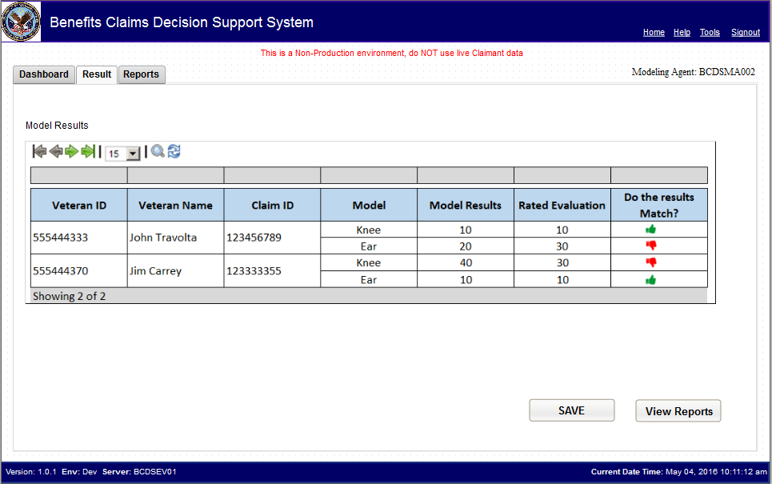
BCDSS – SME Meeting Results Page

Slide 5
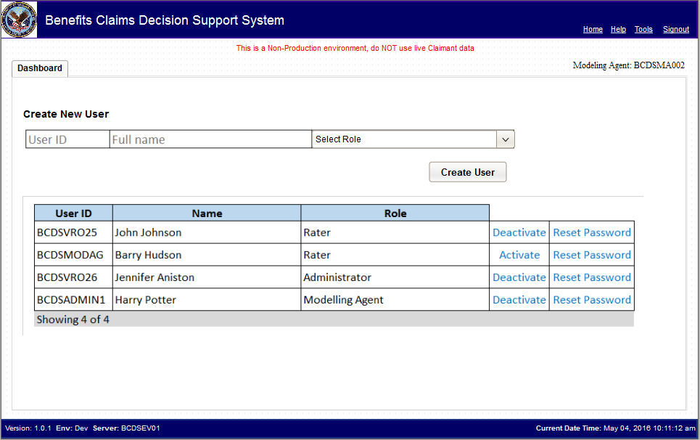
BCDSS – SME Meeting Administrator - Dashboard

Slide 6
BCDSS – SME Meeting Action Items
Action Items from 07/15/2016
• Question on Results page : none
• Admin - workflow
Input fields?
Email ID (input field) required
- Move the Create user button to right
- Add a label for the list of existing users

Slide 7
BCDSS – SME Meeting Questions
?

Slide 8
BCDSS – SME Meeting
Thank you!

